Slide 1
Slide - 1
About Your Presenter
I am not an attorney
Michael F. Brinkash, PLS (PA), LS (NY)
1989-1990 Past President of PSLS
2011-Current 1/25/2023 PLS Member of PA State Registration Board
2022-2024 President Colonial State Boards of Surveyor Registration
Authored and Published 3 Books:
County and Municipal Boundary Descriptions
PA Boundary Commissions and Case Reviews
Waterway Boundaries Along Riparian Lands, Canals & Islands

Slide 2
SURVEYORS CONFERENCE 2023
Navigable + Non-Navigable
Waterways
1. I take a different approach than most presenters. I place all necessary information on the slides, rather than just lines for subject matter and have you fill in the blanks. I will be reading abstracts from the same slides that you are viewing. In the past some people have been offended by this approach.
2. There are a few pictures on slides near the end and many case references.
3. Please feel free to ask questions at anytime.
4. Discussion on past experiences of Land Surveyors in this room, about boundary surveys along waterways?
Slide - 2

Slide 3
SLIDE - 2
WHAT IS THE DEFINITION OF NAVIGABLE
According to cases, and a publication by the National Organization for Rivers, as shown in Chapter Three, Navigable has taken on several different legal meanings.
Slide-3

Slide 4
Slide - 4
On a river that is Navigable for “Title Purposes,” Ownership of the bed and banks of the river passed to the state at the time of statehood (rather than to adjacent landowners, even if the middle of the river is used as a property boundary.)
Case – 1842 - Martin v. Waddell, Confirmation of the “Public Trust Doctrine” that states own the beds of navigable rivers for title purposes and the state holds the land in trust for the people. .
Case – 1845 – Pollard v. Hagan, under the “Equal Footing Doctrine”, confirmed that states owned land under the water based on the public’s right to navigate.

Slide 5
2. On a river that is Navigable for “Commerce Clause Purposes,” the river is subject to federal jurisdiction under the Commerce Clause of the Constitution.
Case – 1824 –Gibbons v. Ogden, court confirmed Federal Jurisdictions over river traffic within one state, New York in this case.
Slide - 5

Slide 6
3. On a river that is Navigable for “Admiralty Law Purposes,” accidents and disputes on the river are governed by admiralty law. (Also called “navigable in the technical sense” or “strictly navigable” in older court decisions.)
Case – 1851 – Genesee Chief v. Fitzhugh, deals with Admiralty and Maritime Law. Maritime Law deals with shipping and warfare on the ocean. Maritime Law governed disputes on the high Sea. Admiralty Laws governed disputes involving ships on arms of the Sea.
Slide - 6

Slide 7
4. On a river (or a stretch or segment of a river) that is Navigable for Clean Water Act Purposes, the river is subject to federal jurisdiction regarding water pollution, under the Clean Water Act. The Federal Water Pollution Control Act of 1972, A/K/A, Clean Water Act is enforced by the U.S. Army Corps of Engineers.
Case - 1974 – U.S. v. Ashland Oil and Transportation Company, it had been determined that Congress does have the authority over non-navigable tributaries of rivers under the Commerce Clause.
Slide - 7

Slide 8
Slide - 8
5. On a river that is Navigable for “Recreational Purposes,” the river is “held in trust for the public” for activities such as boating, fishing, and fowling. (Also called “navigable in the ordinary sense” or “navigable in fact” in older court decisions.)
Case – 1913 – Chandler v. Dunbar, court reaffirmed that flow of a navigable stream (water) is not private property.

Slide 9
2.1 – WHAT IS THE DEFINITION OF NAVIGABLE
1. On a river that is Navigable for “Title Purposes,” Ownership of the bed and banks of the river passed to the state at the time of statehood (rather than to adjacent landowners, even if the middle of the river is used as a property boundary.)
2. On a river that is Navigable for “Commerce Clause Purposes,” the river is subject to federal jurisdiction under the Commerce Clause of the Constitution.
3. On a river that is Navigable for “Admiralty Law Purposes,” accidents and disputes on the river are governed by admiralty law. (Also called “navigable in the technical sense” or “strictly navigable” in older court decisions.)
4. On a river (or a stretch or segment of a river) that is Navigable for Clean Water Act Purposes, the river is subject to federal jurisdiction regarding water pollution, under the Clean Water Act. The Federal Water Pollution Control Act of 1972, A/K/A, Clean Water Act is enforced by the U.S. Army Corps of Engineers.
5. On a river that is Navigable for “Recreational Purposes,” the river is “held in trust for the public” for activities such as boating, fishing, and fowling. (Also called “navigable in the ordinary sense” or “navigable in fact” in older court decisions.)
Slide - 9

Slide 10
Credit For Source Reference:
National Organization for Rivers, Public Rights on Rivers: Canoeing, kayaking, rafting, fishing, and fowling rights, river conservation and water rights (January 2014 - Kindle Locations 2274-2290). Kindle Edition.
Slide - 10

Slide 11
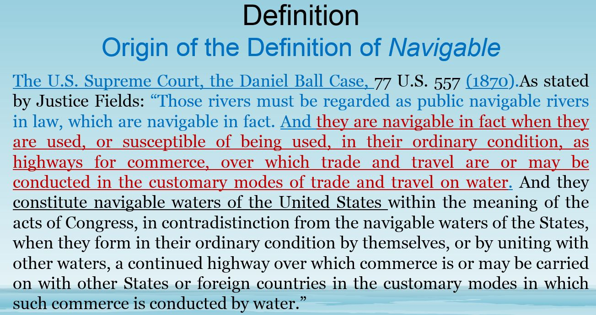
Slide 10-A

Slide 12
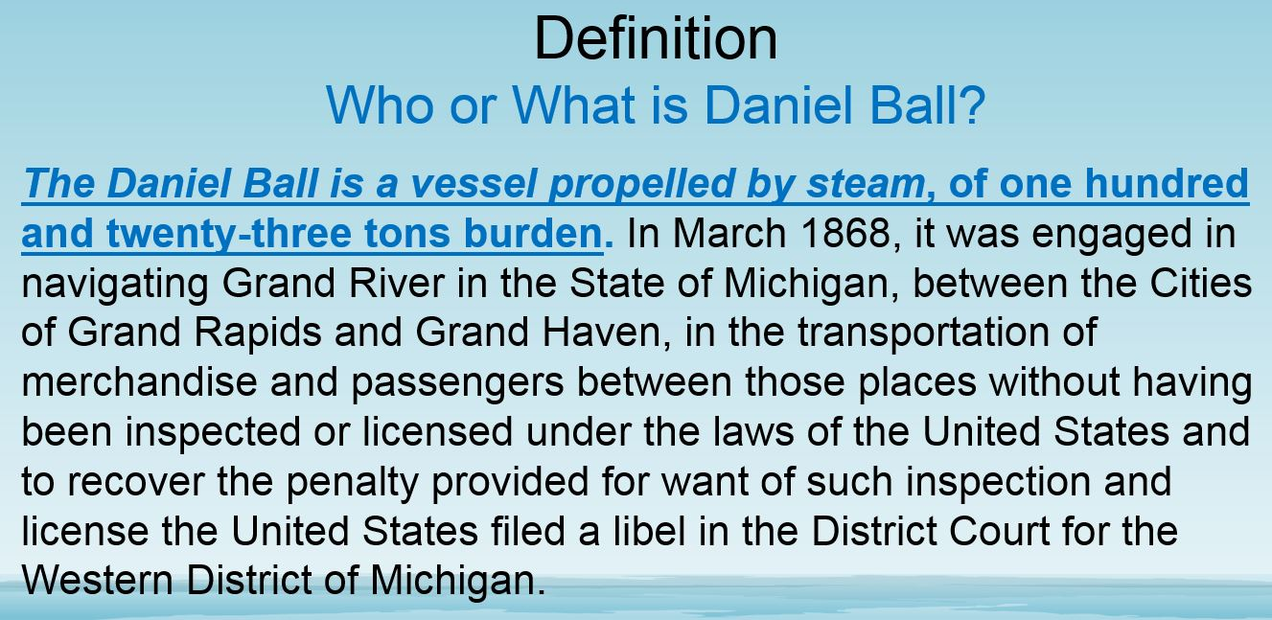
Slide10-B

Slide 13
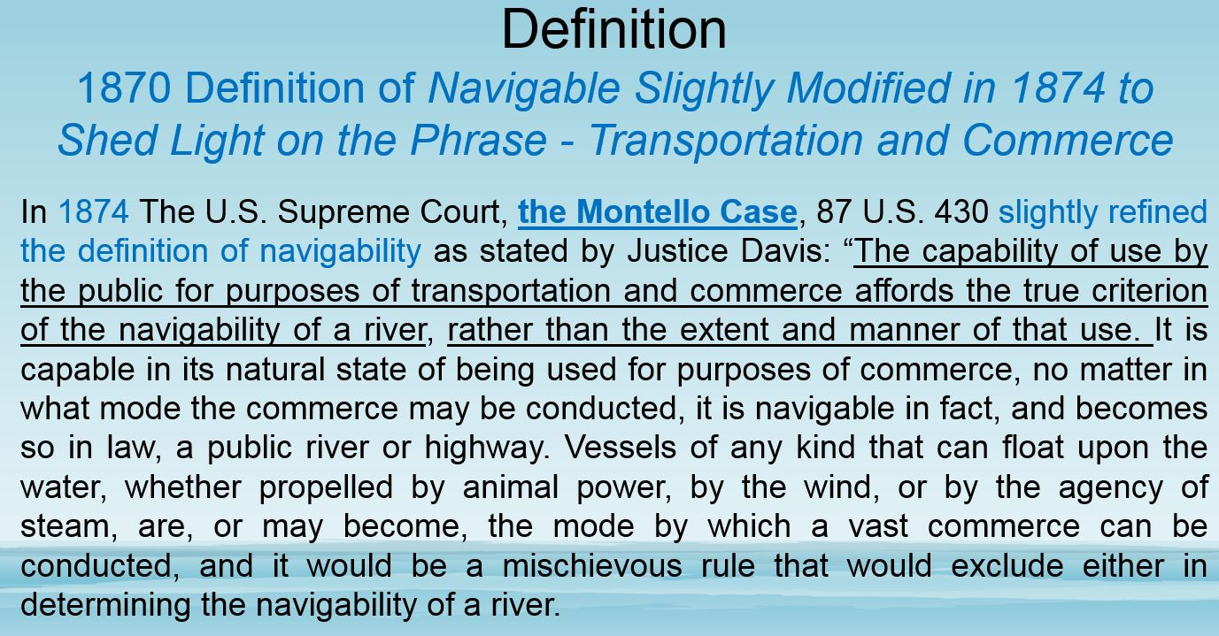
Slide 10-C

Slide 14
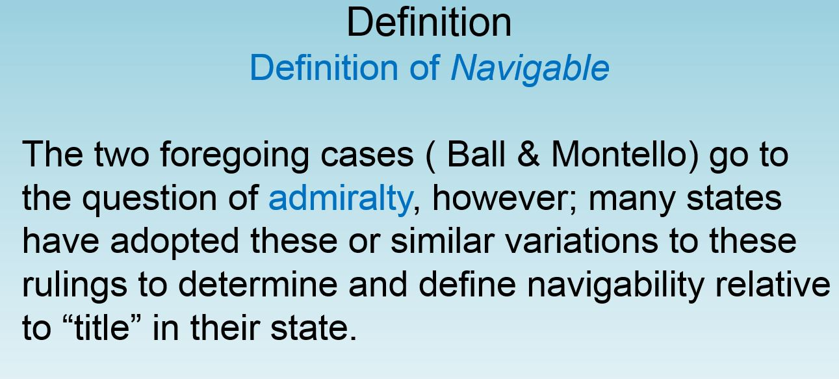
Slide 10-D

Slide 15
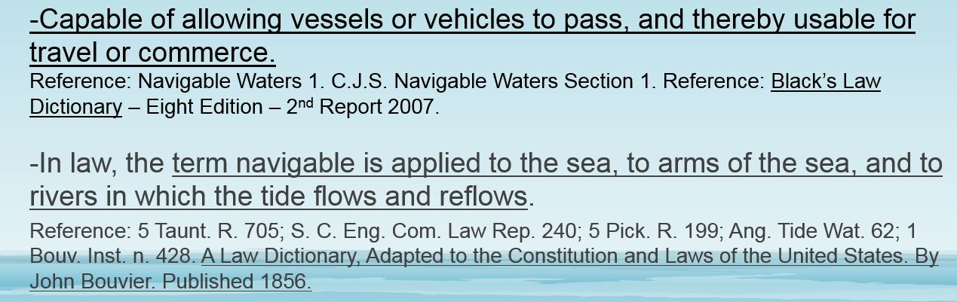
Slide 10-E
Several Other Definitions of Navigable

Slide 16
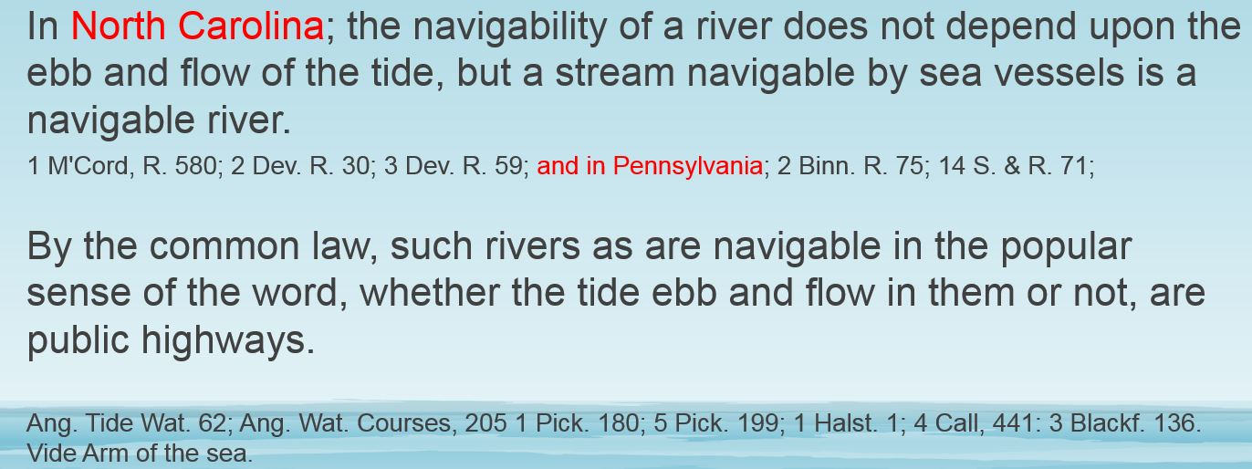
Slide 10-F
Several Other Definitions of Navigable

Slide 17
3.1 – NAVIGABILITY
COMMERCE CLAUSE TEST
VS.TITLE TEST
Slide - 11

Slide 18
The “Federal Title” and “Commerce Clause” Tests of Navigability are the same but with two minor differences.
First, under the commerce clause test, it is not necessary that the waterway be navigable in its “natural and ordinary” condition” it is sufficient if the waterway can be made navigable in fact by “reasonable improvements.”
Second, unlike the title test, commerce clause navigability does not require the watercourse to be susceptible to navigation at the time of statehood; the watercourse may become navigable at some later time.
U.S. v. Appalachian Elec. Power Co., 311 U.S. 377, 416 (1940)
Slide - 12

Slide 19
Slide - 13
Section 3, “Navigable Tests”
Navigable Tests for Federal and State differ slightly. The basic test for both, is that the waterway is obviously navigable and used for commerce purposes. The proving date for state title tests begins with the date of statehood. Inter-state commerce is not necessary as proof with state test.

Slide 20
3.11 - DETERMINING NAVIGABILITY HISTORICAL SEARCH
1. Some have argued that a Historical search is not required to determine the Navigability of a waterway.
This case appears to suggest that it would be wise to perform a Historical Search: P.P. & L Co. vs Maritime Management, Inc. Argued June 18, 1996 – March 20, 1997 PA Superior Court. Judge Kelly Stated in his Opposing Opinion.
2. State Title Test does not require “interstate” commerce although some commerce use is required such as transportation of people, furs, goods or sawn logs. Size of the waterway may be a determinative factor for navigability especially for lakes. See the Section on Body of Lake Laws in Pennsylvania.
Slide - 14

Slide 21
3.11 - DETERMINING NAVIGABILITY HISTORICAL SEARCH SUGGESTIONS
1. Determination of navigability of a waterway as of the date of statehood.
2. Physical condition of the waterway as viewed today and compared to historical reports on the condition of the waterway at time of statehood.
3. Commerce value of waterway for the transportation of people, goods and material to market, i.e. furs, sawn timber.
4. Searches of historical books and other historical records, i.e. old newspapers.
5. Legislative Acts declaring certain waterways to be Navigable.
Slide - 15

Slide 22
3.11 - DETERMINING NAVIGABILITY HISTORICAL SEARCH SUGGESTIONS
6. Legislative Acts allocating tax money to improve the waterway for navigation.
7. Court decrees, declaring certain waterways to be navigable.
8. Navigable list prepared by the Corp of Engineers.
9. Navigable list prepared by State or Federal Agencies.
Slide - 16

Slide 23
3.11 – DETERMINING NAVIGABILITY HISTORICAL SEARCH SUGGESTIONS
Historical reports provided by court records or by knowledgeable people.
11. Deeds. Measurements and Deed Calls.
12. Archived records; original warrants and patents.
13. Land Grants predating state-hood. (State Archives).
Note: You may want to do line suggestions 12 & 13 First.
Slide - 17

Slide 24
18.3 PENNSYLVANIA NAVIGABLE LEGISLATIVE ACTS
LEGAL OR NOT LEGAL?
Slide - 18

Slide 25
18.3 PENNSYLVANIA NAVIGABLE LEGISLATIVE ACTS - LEGAL OR NOT LEGAL?
The laws enacted by the PA Legislators relative to navigable waterways between 1771 and 1874 should be treated as legal from a surveyor’s point-of-view.
Although there are some PA Cases that suggest that these Acts of Legislation are not legal, it is not the surveyor’s job to make a final legal determination of whether or not a waterway is legal. This is the job for the court and the job of the surveyor is one of reporting known facts such as navigable or non-navigable based on records.
The classification of the waterway, affects the location of boundary lines and title to private property. All of these acts are subject to court review and only the courts can remove any encumbrance of navigable from the title of the land created by the passage of these Acts.
Slide - 19

Slide 26
18.3 THREE PENNSYLVANIA CASES SUGGESTING NAVIGABLE LEGISLATIVE ACTS ARE NOT LEGAL?
1. If the stream is not actually navigable, so that there is no public right of way therein, a declaration by the legislature that it shall be regarded as navigable is a taking of private property for public use, and unless compensation is made the statute will be in conflict with the constitutional provision requiring compensation in such cases. The issue of whether the legislature may statutorily render a body of water navigable was addressed in Commonwealth v. Foster, 36 Pa.Super. (23)1908
Slide - 20

Slide 27
CASE EXAMPLE NO. 2
2. Navigable in fact is navigable in law, however; navigable in law is not necessarily navigable In fact. If a River, Creek, or Stream is not in fact navigable it cannot be made so by the mere passage of a Legislative Act., - Id. At 435 (quoting Barclay Railroad & Coal Co. v. Ingham, 36 Pa. 194). (22) – 1860.
Slide - 21

Slide 28
Slide - 22
CASE EXAMPLE NO. 3
3. If navigable in fact, it is so in law; it is public and no such statute need be considered. If not navigable-in-fact, it is not so in law and no statute can make it public, for the owners had title to the center of the
waterway that cannot be divested by mere legislation. (Smoulter v. Boyd, PA supra.) - 1904

Slide 29
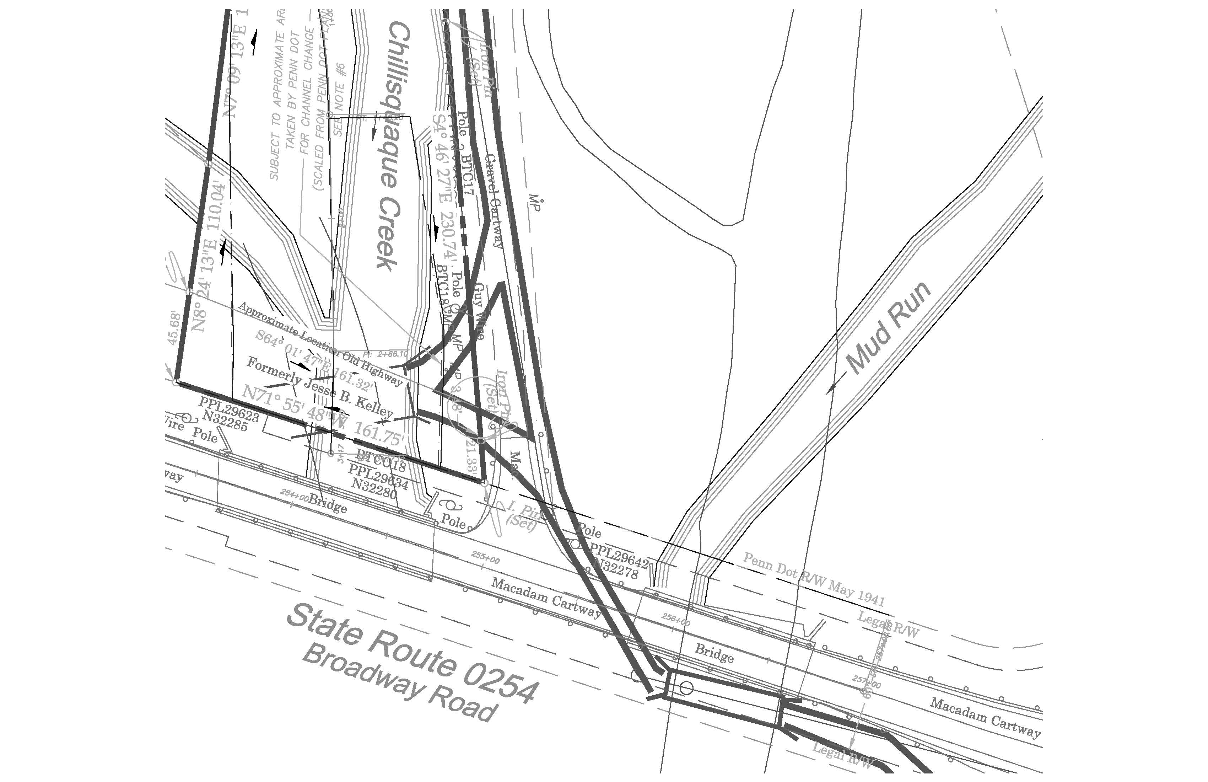
Slide - 23

Slide 30
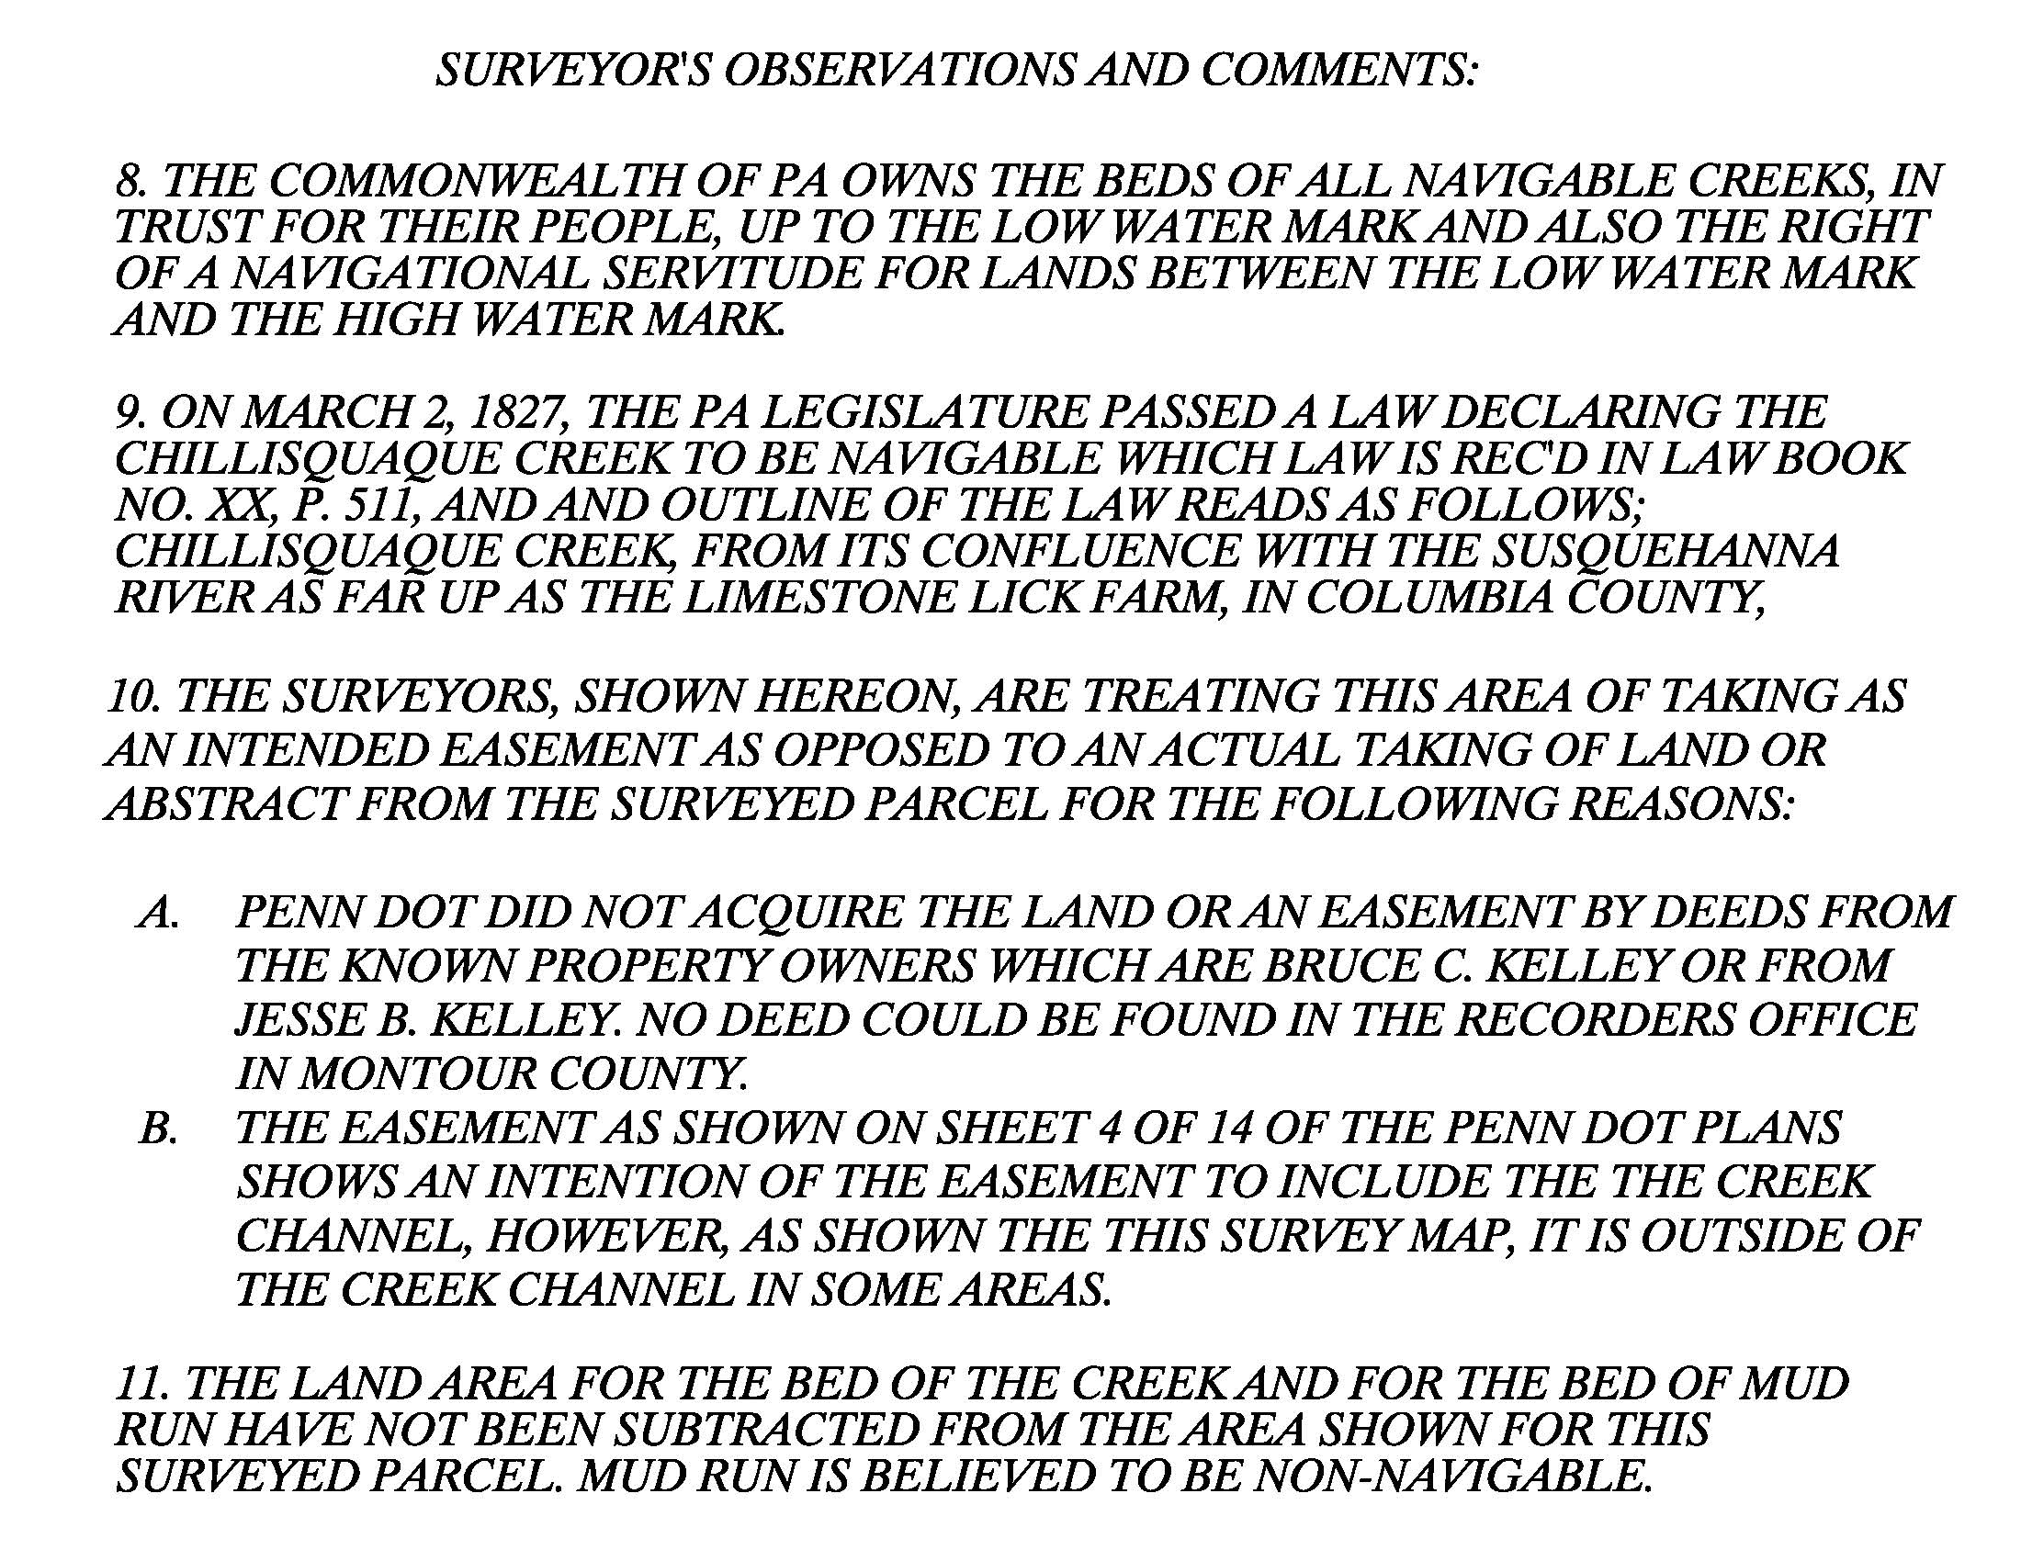
Slide 24
NOTES 8 & 9 APPLY TO THE CREEK

Slide 31
WHERE IS THE BOUNDARY LINE
ALONG WATERWAYS?
In Pennsylvania the location of the boundary line along a waterway will either be the thread of the waterway or the low water mark.
Slide - 25

Slide 32
WHERE IS THE BOUNDARY LINE ALONG NON-NAVIGABLE WATERWAYS?
If the waterway is non-navigable, then the boundary line of the riparian owners extends to either the center of the waterway in cases of larger waterways or to the thalweg of the waterway, which is the deepest channel, in smaller waterways. When the riparian boundary lines go to the center, there is always a navigational servitude against the riparian owner and in favor of the state, in trust for the public to float boats or rafts through the riparian lands and on the waterway. No one person or entity owns the water and it is treated like the air we breathe.
Slide – 26

Slide 33
WHERE IS THE BOUNDARY LINE ALONG NAVIGABLE WATERWAYS?
The riparian boundary line along a “navigable waterway” extends to the low water mark. The riparian owner has conditional title to the low water mark and absolute title to the high water mark. There exist a navigable servitude between the low water mark and the high water mark in favor of the state held in trust for public use. Regardless of waterway classification, the navigational servitude exist in both navigable and non-navigable waterways. I did question the State’s claim about a navigational servitude existing on a non-navigable waterway. I guess they got tired of dealing with me, because they dropped communications. Case study shows; whoever owns the bed of the waterway, controls activities on the waterway.
Slide - 27

Slide 34
HOW TO IDENTIFY THE HIGH WATER MARK
Field Indicators are used to determine Ordinary High Water Mark (OHWM), which is required for establishing the lateral extents of U.S. Army Corps of Engineers (Corps) jurisdiction in non-tidal streams.
Ordinary High Water Mark (OHWM) Corps regulations for the Clean Water Act identify the lateral extents of non-tidal streams at 33 CFR 328.3(e), which states:
“The term ordinary high water mark means that line on the shore established by the fluctuations of water and indicated by physical characteristics such as a clear natural line impressed on the bank, shelving, changes in the character of soil, destruction of terrestrial vegetation, the presence of litter and debris, or other appropriate means that consider the characteristics of the surrounding areas.”
Slide - 28

Slide 35
Slide - 29
HOW TO IDENTIFY THE HIGH WATER MARK AND THE LOW WATER MARK
The following physical characteristics should be considered when making an OHWM determination:
Scour, sediment sorting, deposition, water staining, shelving, changes in the character of soil, destruction of terrestrial vegetation, natural line impressed on the bank, presence of litter and debris, multiple observed flow events, wracking, bed and banks, vegetation matted down, bent, or absent, leaf litter disturbed or washed away, change in plant community.
In Pennsylvania, the courts have defined the low water mark in this context as the height of water at ordinary stages of low water unaffected by drought and unchanged by artificial means. (See: https://www.fishandboat.com/LearningCenter/FAQs/Pages/PublicAccess.aspx )
(Slide edited 1/26/2023, to include definition of low water mark)

Slide 36
LEGISLATIVE ACTS
IF YOUR CLIENT OR THEIR ATTORNEY REQUEST
THAT YOU PERFORM A HISTORICAL SEARCH,
RELATIVE TO THE NAVIGABILITY OF A
CREEK RUNNING THROUGH THEIR PROPERTY,
WHAT DO YOU DO?
Slide - 30

Slide 37
FOLLOW THESE STEPS:
REFER TO THE GEIGER LIST OF NAVIGABLE STREAMS (See Handouts)
In 1890 the PA Fish Protective Association commissioned Frederick J. Geiger, Esq. to compile a list of Navigable-in-Law waterways. The list is similar to the list appearing in the book by Knud Hermansen, Esq, PLS, PE.
2. REFER TO THE CURRENT LIST OF NAVIGABLE STREAMS PREPARED BY THE ARMY CORPS OF ENGINEERS
3. REFER TO THE CURRENT LIST OF NAVIGABLE STREAMS PREPARED BY THE DEPARTMENT OF ENVIRONMENTAL PROTECTION (DEP – PENNSYLVANIA)
Slide - 31

Slide 38
SCENARIO 1
THE STREAM NAME DOES APPEAR ON A LIST
YOU HAVE DETERMINED THAT THE STREAM OF INTEREST HAS BEEN DECLARED NAVIGABLE BY AN ACT OF LEGISLATION.
TITLE SEARCH THE PROPERTY OF INTEREST BACK TO THE ORIGINAL LAND PATENT.
COMPARE THE DATE OF THE LEGISLATIVE ACT TO THE DATE OF THE PATENT. BASED ON THE DATES, WHO WAS THE OWNER OF THE LAND AT THE STREAM WHEN THE LEGISLATIVE ACT PASSED?
Slide - 32

Slide 39
SCENARIO 1 - CONTINUED DOES APPEAR ON A LIST
4. IN THIS SENARIO, ASSUME THAT THE COMMONWEALTH WAS STILL IN OWNERSHIP OF THE LAND WHEN THE LEGISLATURE ENACTED THE LAW DECLARING THE STREAM TO BE NAVIGABLE.
5. THE ACT OF LEGISLATION WOULD BE OF AUTHORITY SINCE THE COMMONWEALTH OWNED THE LAND AND THEY DID NOT TAKE ANYONE’S LAND WITHOUT PAYING FOR IT. THE FIRST BUYER OF THIS LAND, WOULD TAKE OWNERSHIP, SUBJECT TO THE EASEMENT OF THE NAVIGABLE STREAM BY VIRTUE OF THE ACT.
Slide - 33

Slide 40
SCENARIO 2
THE STREAM NAME DOES NOT APPEAR ON ANY LIST
OF NAVIGABLE STREAMS
YOU HAVE DETERMINED THAT THE STREAM OF INTEREST HAS NOT BEEN DECLARED NAVIGABLE BASED ON A REVIEW OF ALL LIST AVAILABLE TO YOU.
TITLE SEARCH THE PROPERTY OF INTEREST BACK TO THE ORIGINAL LAND PATENT.
SEARCH HISTORY BOOKS OF THE MUNICIPALITY FOR THE STREAM NAME. MAKE NOTE OF ALL COMMERCIAL USES OF THE STREAM.
Slide - 34

Slide 41
SCENARIO 2 - CONTINUED
THE STREAM NAME DOES NOT APPEAR ON ANY LIST
OF NAVIGABLE STREAMS
SEARCH LAW BOOKS FOR LEGISLATIVE ACTS APPEARING
DURING THE TIME PERIOD OF THE DATE OF THE ORIGINAL
WARRANT OR PATENT. DID THE LEGISLATORS PASS ANY ACTS
FOR IMPROVEMENT OF NAVIGATION FOR THE STREAM?
5. THERE IS NO MENTION OF THE STREAM NAME IN ANY HISTORY
BOOKS OR LAW BOOKS.
Slide - 35

Slide 42
SCENARIO 2 - CONTINUED
THE STREAM NAME DOES NOT APPEAR ON ANY LIST
OF NAVIGABLE STREAMS
6. ARE THERE ANY LOCAL REPORTS OF THE STREAM EVER BEING USED FOR TRANSPORTATION OF PEOPLE OR GOODS?
IF NOTHING CAN BE FOUND AND THERE ARE NO REPORTS OF THE STREAM BEING USED FOR COMMERCIAL PURPOSES, THE STREAM IS PROBABLY NON-NAVIGABLE
Slide - 36

Slide 43
REMEMBER: REPORTS PREPARED BY FEDERAL & STATE AGENCIES, DECLARING STREAMS TO BE NAVIGABLE, ARE SAID TO BE JUSTIFIED THROUGH:
COMPLETE LEGAL ANALYSIS OF THE WATERWAY, THOROUGH HISTORICAL RESEARCH, AND SEARCHES OF RECORDS OF PENNSYLVANIA COURT DECISIONS.
Slide - 37

Slide 44
FREQUENTLY ASKED QUESTIONS
PENNSYLVANIA FISH AND BOAT COMMISSION
PUBLIC RIGHTS IN PENNSYLVANIA WATERS
http://fishandboat.com/water/public/faq_public_waters.htm#top
Slide - 38

Slide 45
ARE PENNSYLVANIA’S WATERS CONSIDERED PUBLIC AND THEREFORE OPEN TO LEGAL FISHING AND BOATING?
Some are; some aren’t.
In addition to the legal status of the waterway itself, the status of the adjacent - or “riparian” - lands play a significant role in determining who has what rights. Unfortunately, a brief answer cannot comprehensively address this complex subject, which has generated major court decisions and lengthy law review articles
Slide - 39

Slide 46
2. SO WHICH WATERS ARE CONSIDERED TO BE PUBLIC?
Public waters include the great or principal rivers of the Commonwealth. The Pennsylvania Supreme Court in Shrunk v. Schuylkill Navigation Company in 1826 defined the great rivers to be the Ohio, Monongahela, Youghiogheny, Allegheny, Susquehanna, and its north and west branches, Juniata, Schuylkill, Lehigh and Delaware. Public waters also include “legally navigable” rivers, streams and lakes.
Slide - 40

Slide 47
3. WHAT MAKES A RIVER, STREAM OR LAKE NAVIGABLE FOR LEGAL PURPOSES?
Waterways must be regarded as “navigable in law if they are navigable in fact.” According to the United States Supreme Court in The Daniel Ball in 1870, waterways are “navigable in fact” when they are used or are susceptible of being used in their ordinary condition as highways for commerce over which trade and travel are or may be conducted in customary modes of trade and travel on water.
Slide – 41

Slide 48
4. DOES THAT MEAN THAT A WATERWAY MUST CURRENTLY BE USED FOR COMMERCIAL PURPOSES IN ORDER TO BE NAVIGABLE?
No. The test for navigability is not a contemporary test. It’s a historic test that goes back to when William Penn was granted charter to Pennsylvania. Pennsylvania courts place particularly emphasis on a waterway’s use during the late 18th and early 19th centuries – prior to the invention of modern modes of transportation and at a time when the only significant routes of travel, trade and commerce were on waterways.
Slide - 42

Slide 49
5. WHAT IF A WATER THAT WAS USED FOR COMMERCE DURING THE LATE 18TH AND EARLY 19TH CENTURIES IS NO LONGER USED FOR COMMERCIAL PURPOSES TODAY?
It doesn’t matter. The test of navigability is rooted in its historical use.
Slide - 43

Slide 50
6. DOES SIGNIFICANT RECREATIONAL USE MAKE A WATERWAY NAVIGABLE?
No. Only commercial use is considered by the courts. (PA)
Slide - 44

Slide 51
7. DOES THE FISH AND BOAT COMMISSION DETERMINE WHICH WATERS ARE NAVIGABLE AND THEREFORE PUBLIC?
No. Only a court can decide. No agency, including the Fish and Boat Commission, is authorized to determine navigability by administrative action.
EXCEPT: Commonwealth Court of PA has recently ruled that the PA Board of Property has the Authority to determine Navigability of PA Waterways.
Slide - 45

Slide 52
8. WHO OWNS PUBLIC WATERS? (Public Means Navigable)
The title to the beds of public waters is held in trust by the Commonwealth of Pennsylvania for the benefit of the public. In case of rivers and streams, the Commonwealth’s ownership extends to ordinary low water mark, and the adjacent riparian landowner owns above the low water mark. An easement exists in favor of public between high and low water marks. That easement includes the right to fish. In case of lakes, Commonwealth’s ownership encompasses the mean pool of lake.
Slide - 46

Slide 53
9. HOW MUCH OF A NAVIGABLE WATERWAY DOES THE COMMONWEALTH OWN?
When it comes to navigable waters, Pennsylvania courts have said that the Commonwealth’s ownership extends to the ordinary low water mark, and the adjacent riparian landowner owns above the ordinary low water mark. An easement exists in favor of public between the high and low water marks.
Slide - 47

Slide 54
9. CONTINUED
That easement includes the right to fish. The courts have defined the low water mark in this context as the height of water at ordinary stages of low water unaffected by drought and unchanged by artificial means. The best advice is to tell the public to stay as close to the water as possible or if they want to be safe to stay in the water. If they don’t venture on to upland properties, they’ll be OK. The fact that a waterway is deemed navigable does not give the public unfettered access to people's riparian lands nor permission to trespass in order to gain access to a waterway.
Slide - 48

Slide 55
10. WHAT RIGHTS DOES THE PUBLIC HAVE IN PUBLIC WATERS?
The rights of the public in public waters are quite broad and extend to fishing, boating, wading, floating, swimming and otherwise recreating.
Do the rights of the public include being able to cross private property to gain access to the public waters?
No. The public does not have a right to cross on private property to gain access to public waters. However, if you enter a public waterway lawfully (e.g., through a public access point), you can wade, boat, float or otherwise be in the waterway where it passes through private property.
Slide - 49

Slide 56
12. CAN RIPARIAN LANDOWNERS PREVENT MEMBERS OF THE PUBLIC FROM FISHING IN PUBLIC WATERS THAT FLOW THROUGH THEIR PROPERTY?
No.
Slide - 50

Slide 57
13. IS THERE A LIST OF PUBLIC WATERS?
Unfortunately, no.
Slide - 51

Slide 58
14. WHAT WATERS ARE CONSIDERED
TO BE PRIVATE?
Private waters are non-navigable rivers, streams and lakes.
Slide – 52

Slide 59
15. WHO OWNS PRIVATE WATERS?
Title to the beds is held by the adjacent riparian landowner. If the adjacent riparian landowner owns property on only one side of a non-navigable waterway, he or she owns to the middle. When a non-navigable waterway flows through someone’s property, he or she owns the entire bed of the waterway.
Slide - 53

Slide 60
16. CAN A RIPARIAN LANDOWNER PREVENT MEMBERS OF THE PUBLIC FROM FISHING OR WADING IN A NON-NAVIGABLE WATER?
Yes.
Slide - 54

Slide 61
17. CAN A RIPARIAN LANDOWNER PREVENT THE PUBLIC FROM BOATING OR FLOATING IN A NON-NAVIGABLE STREAM?
No, because there’s a “navigation servitude” that gives the public the right to use the water for purposes of navigation only. This servitude does not extend to fishing.
*** The owner in fee of lands beneath water has the right to control activities
on the surface. Smoulter v. Boyd, 209 Pa. 146, 58 A. 144 (1904).
Slide - 55

Slide 62
18. CAN A RIPARIAN LANDOWNER STRING A CABLE ACROSS A NON-NAVIGABLE STREAM?
Yes, as long as:
  the landowner owns property on both sides of the stream; and
  the cable doesn’t interfere with navigation.
However, from a liability perspective, it may not be a good idea. (This is added comment, by MFB).
Slide - 56

Slide 63
Slide - 57
Discussion:
An attorney contacted me for my opinion on a navigable creek situation.
His client had a large parcel of land consisting of a few hundred acres. A creek ran through the property at about the center of it. The heirs of the estate and the attorneys suggested to use the middle of the creek as the dividing line to cut the large parcel into two parcels to settle the estate. The under-lying title to the creek was included in the deed of the few hundred acres. The surveyor refused to do this because his opinion was that the Commonwealth owned the creek bed and banks based on the Legislative Act declaring the creek to be navigable.
What would you do as a land surveyor?

Slide 64
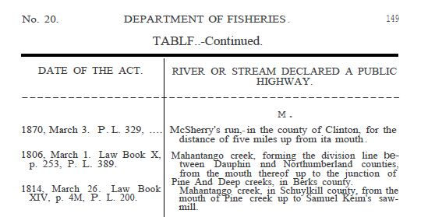
Slide - 58
Mahantango Creek
Locate This in Your Handout
Two Legislative Acts for the Mahantango Creek Calling through Dauphin, Northumberland, Berks and Schuylkill Counties.

Slide 65
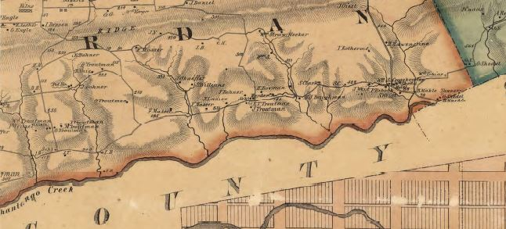
Slide - 59
Historic Map of Northumberland County, Shows the Mahantango Creek as the Boundary Line Between Dauphin County & Northumberland County
Northumberland County
Dauphin County

Slide 66
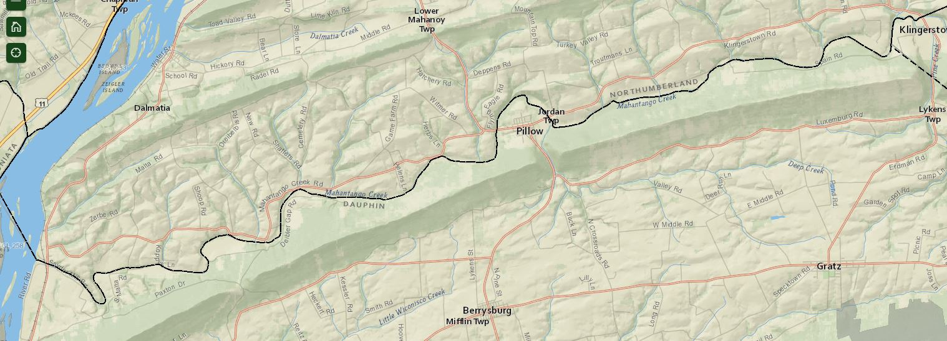
Slide - 60

Slide 67
Slide - 61
PA Land Warrant
A land warrant authorized an official survey of a particular tract of land that an individual or other entity wanted to claim or purchase. While it initiated the title process, the warrant did not confer title to the land.
PA Land Patent
The patentee generally was the person who settled the land and acquired title to it.

Slide 68
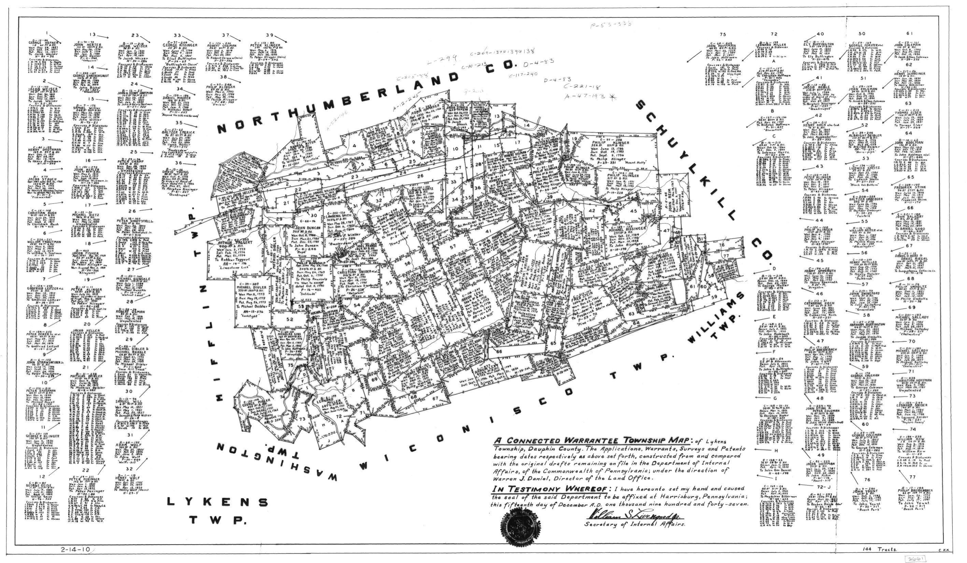
Slide - 62

Slide 69
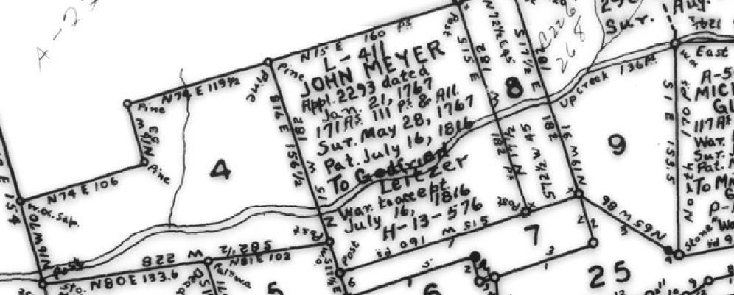
Slide - 63
Clip Showing 4 Contiguous Warrants From the Larger Connected Warrant Map = #4, John Meyer Differs From Patentee (Leitzer), #8 & #9
Mahantango Creek
Northumberland County
Dauphin County

Slide 70
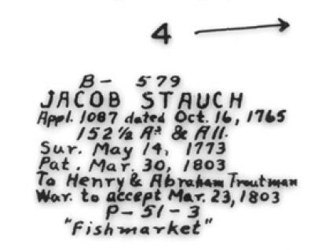
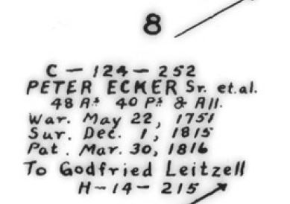
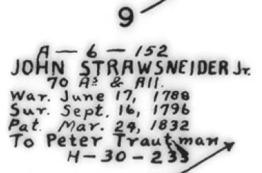
Dates of Two Legislative Laws = 1806 March 1 & 1814 March 26 Compared to Patent Dates of Warrants
Slide - 64

Slide 71
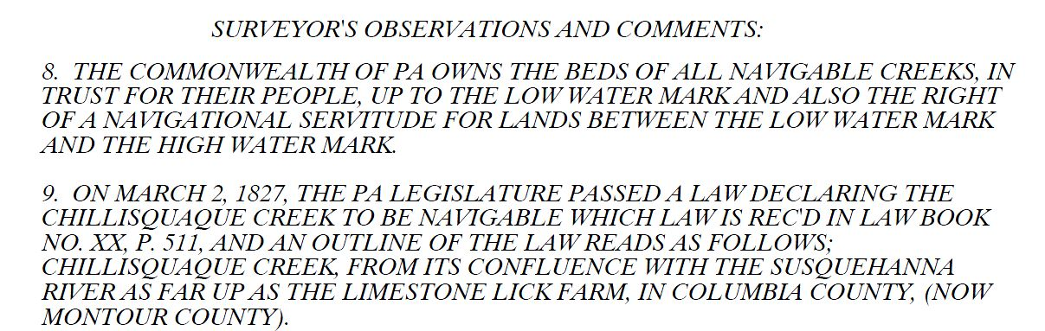
Slide - 65
Place Whatever You Consider an Appropriate Note on Your Plan to Address the Situation.

Slide 72
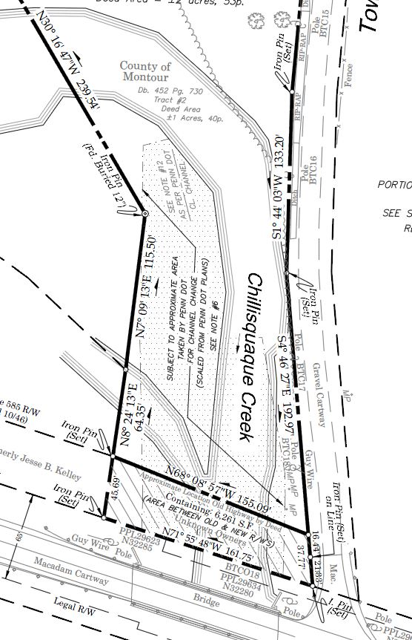
Slide - 66
The Creek limits are not accurately defined with this survey even thought it is a Navigable Creek. The bed and banks are shown to be within the surveyed parcel of interest. All creeks declared Navigable by the Legislators are, or maybe, subject to court review. A historical search was not done on the Navigability of Chillisquaque Creek.

Slide 73
Slide - 67
End of Slides
The following slides were not presented at Surveyors Conference 2023

Slide 74
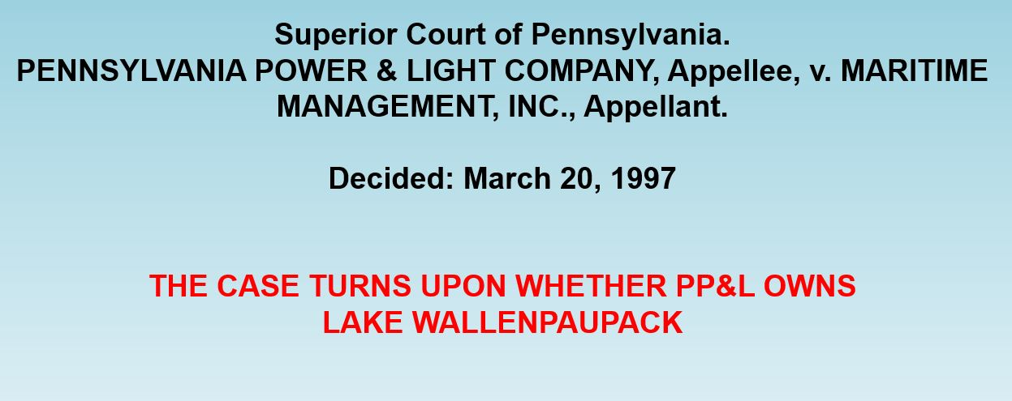
Slide - 68

Slide 75
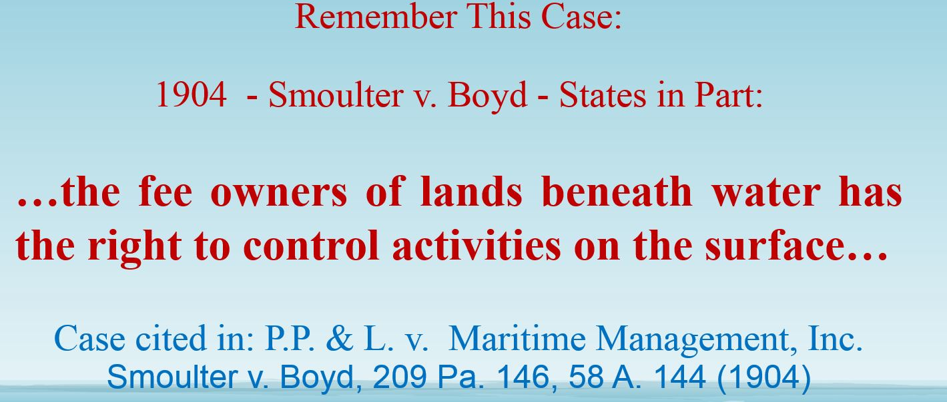
Slide - 69

Slide 76
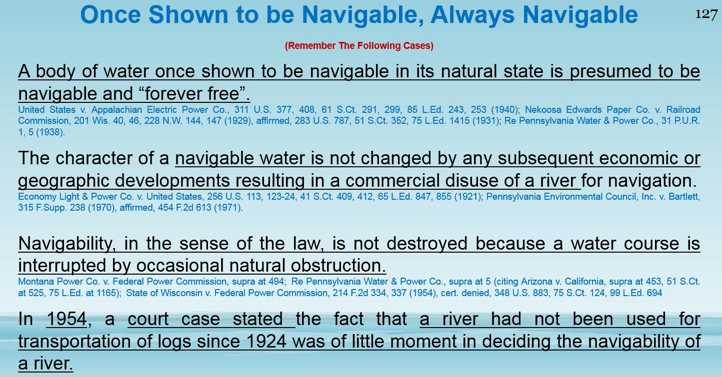
Slide - 70

Slide 77
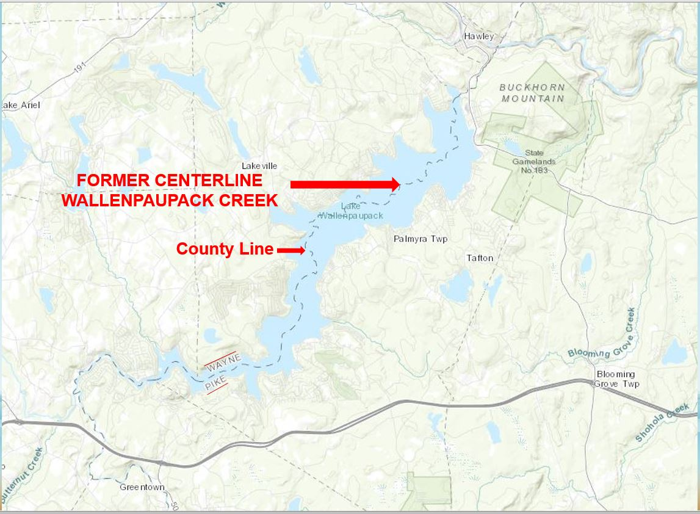
Slide - 71

Slide 78
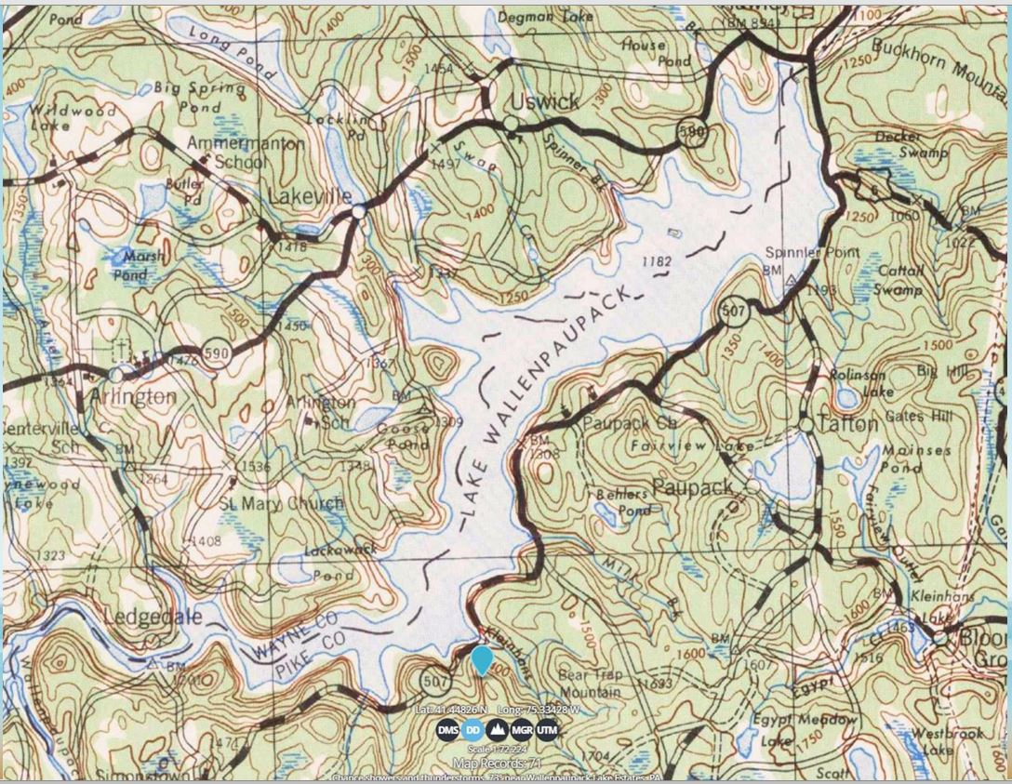
Slide - 72

Slide 79
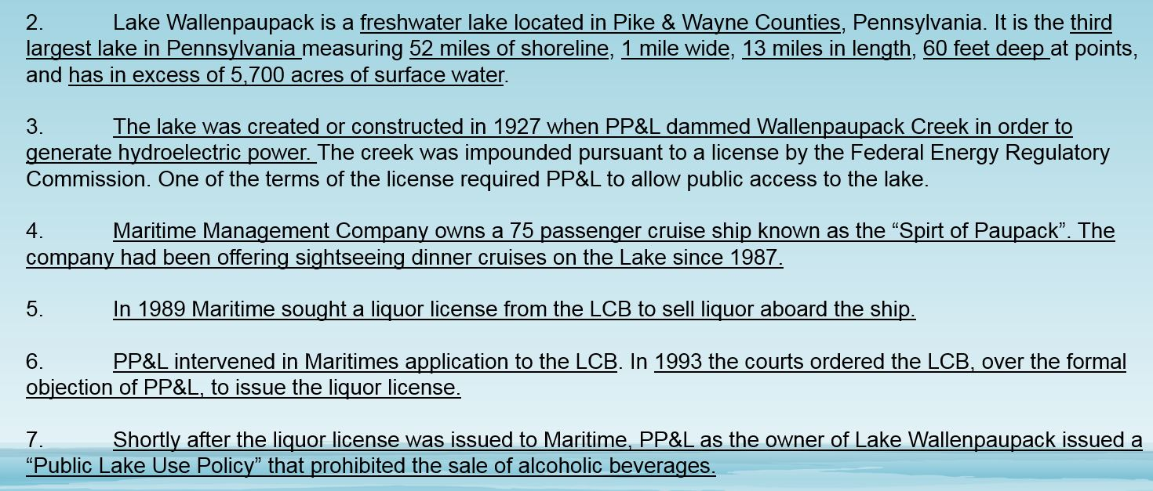
Slide - 73

Slide 80
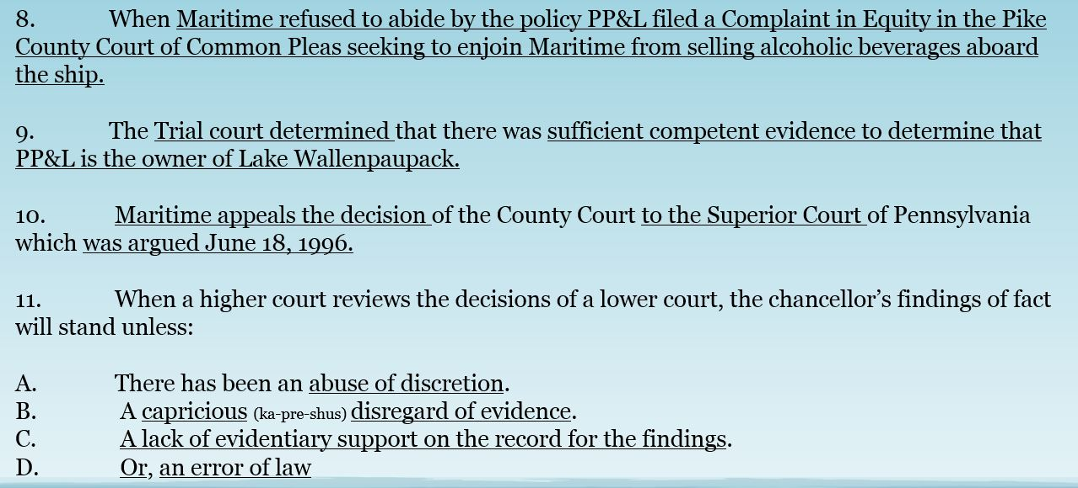
Slide - 74

Slide 81
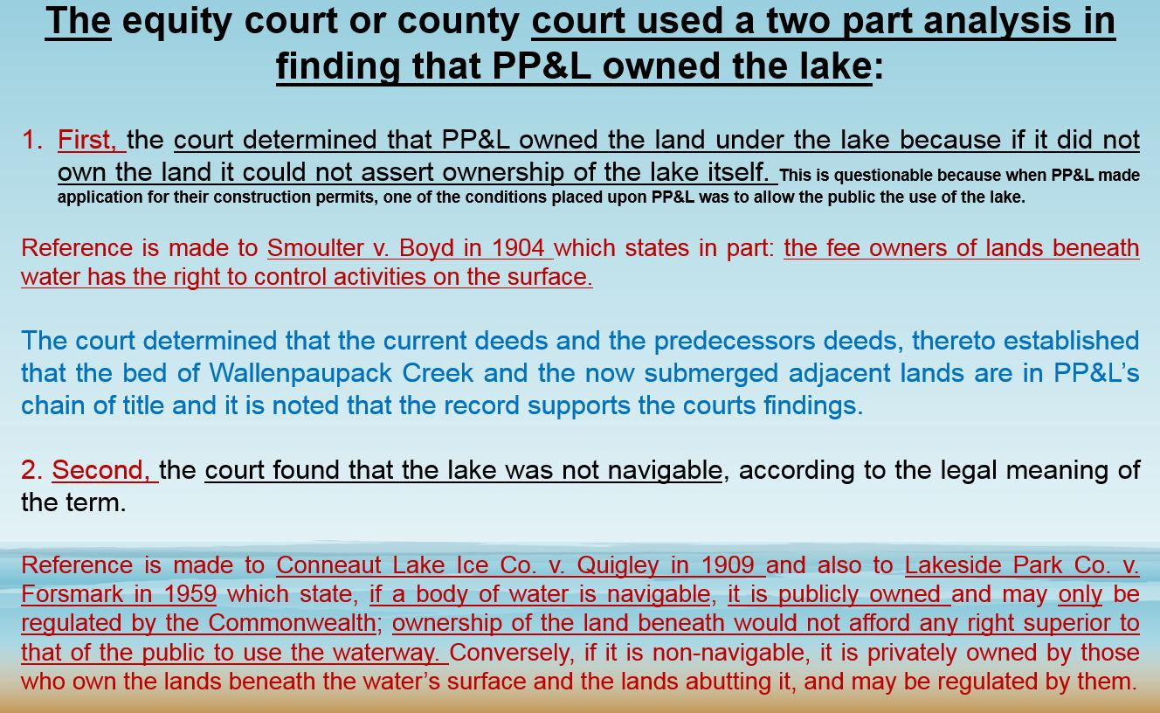
Slide - 75

Slide 82
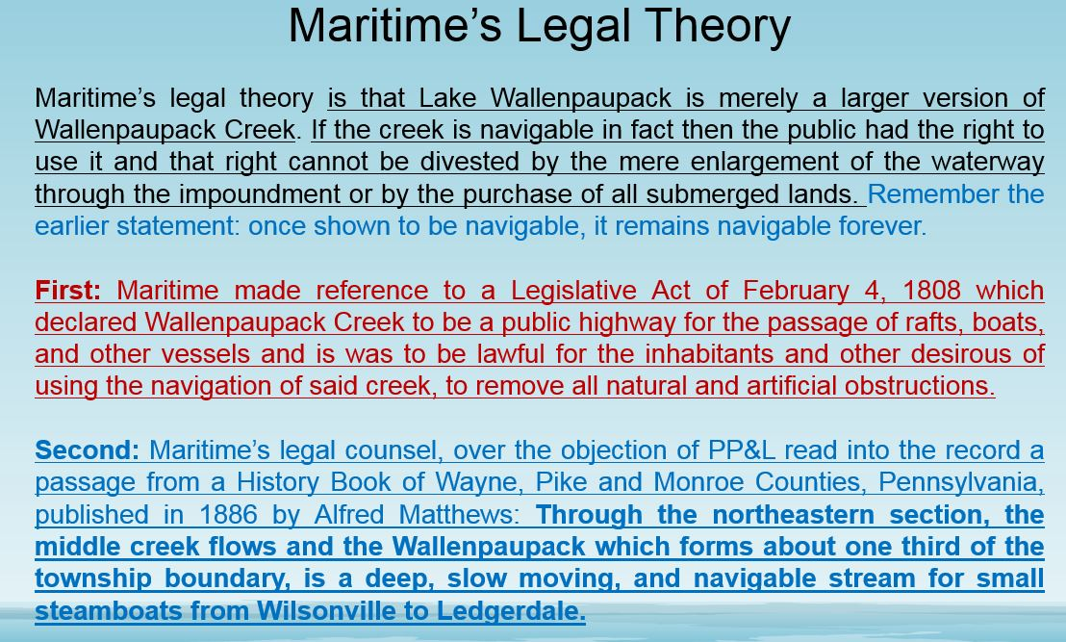
Slide - 76

Slide 83
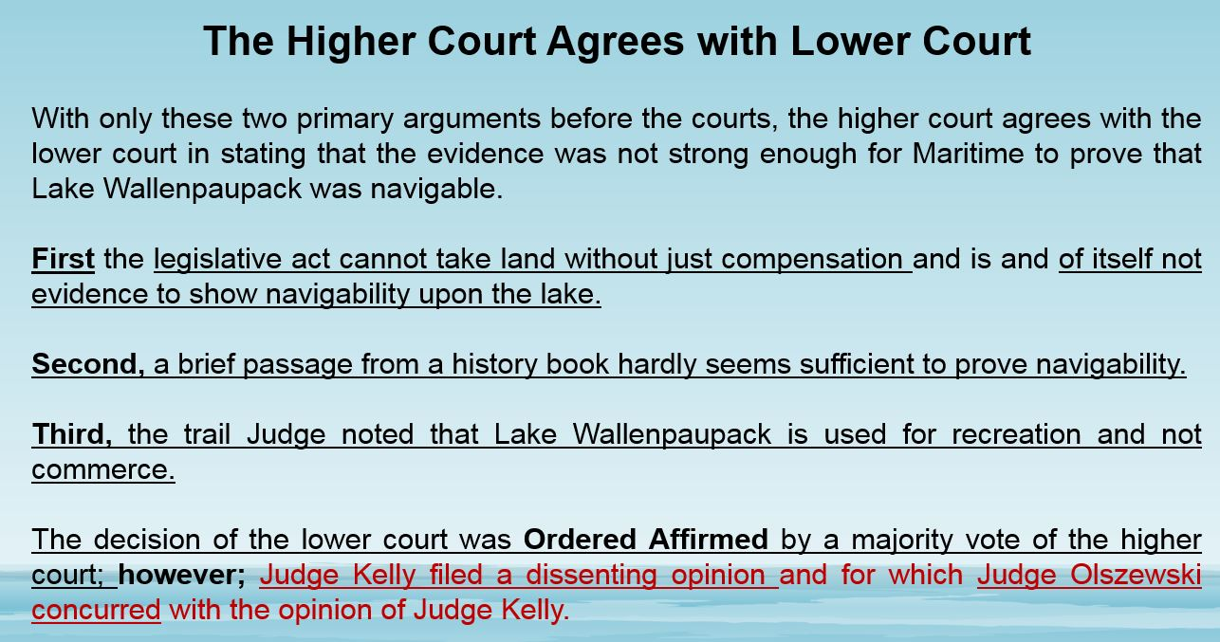
Slide - 77

Slide 84
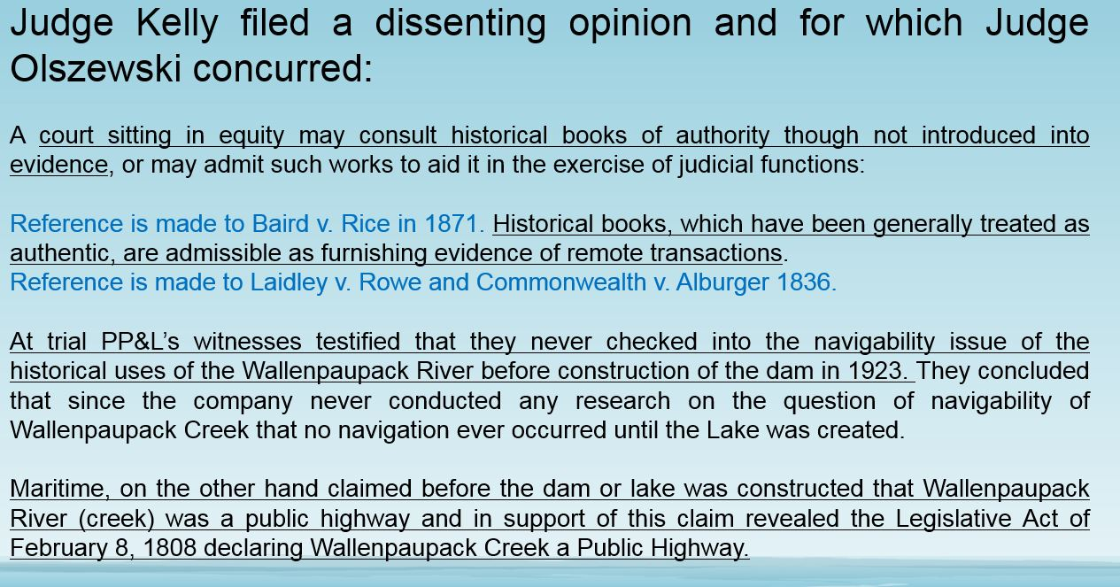
Slide - 78

Slide 85
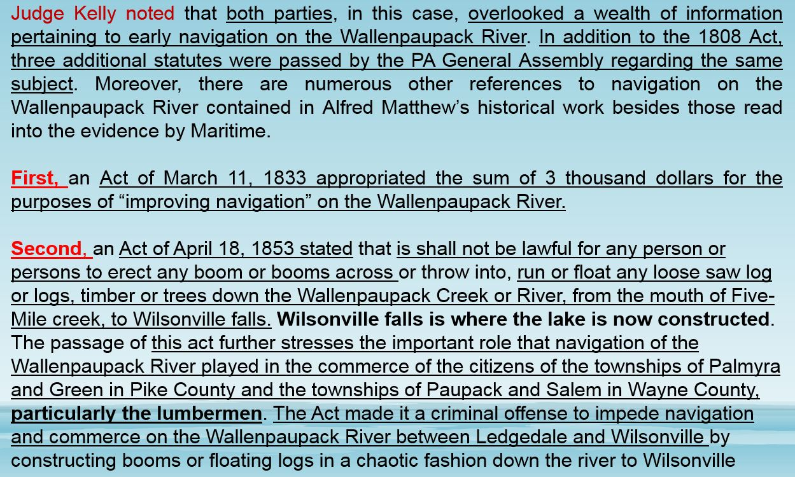
79

Slide 86
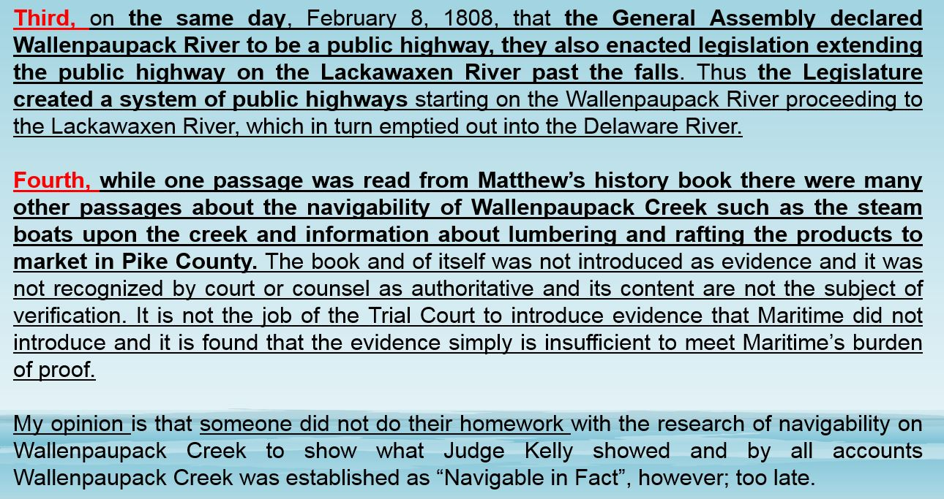
Slide - 80

Slide 87
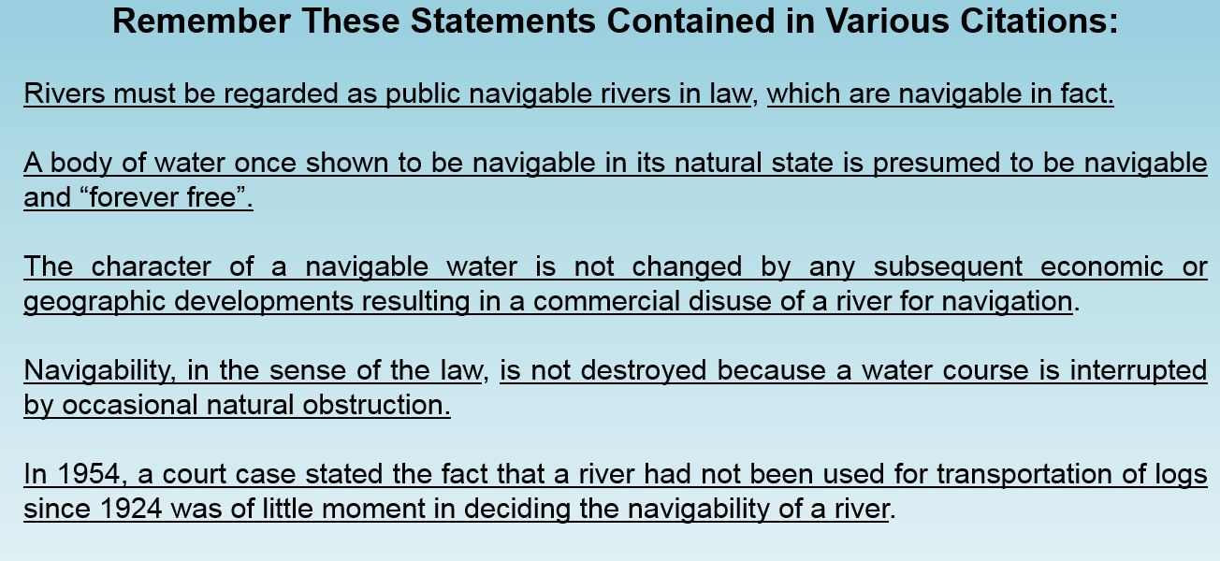
Slide - 81

Slide 88
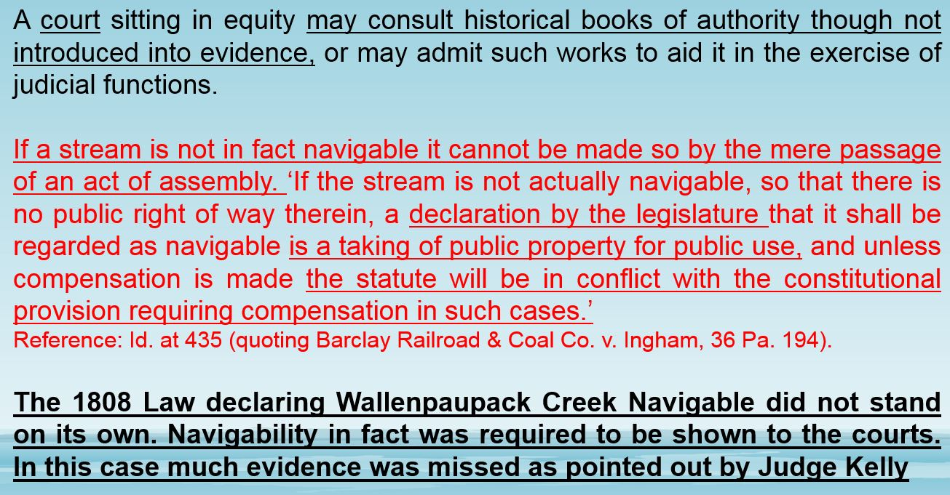

Slide 89
END OF SLIDES

