Slide 1

Using Junior Senior Deed Rights in Solving a Boundary

Slide 2
BIO of Kevin Norris
MORE THAN THIRTY-FIVE YEARS OF EXPERIENCE IN LAND SURVEYING, MINOR ENGINEERING, AND LAND DEVELOPMENT.
LICENSED PROFESSIONAL LAND SURVEYOR IN THE STATE OF MARYLAND SINCE 2002.
LICENSED ATTORNEY IN THE STATE OF MARYLAND & TEXAS
SOLO PRACTITIONER AND SELF-EMPLOYED SURVEYOR

Slide 3
Disclosure
I AM NOT GIVING ANY LEGAL ADVICE; AND I AM NOT CREATING A CLIENT/ATTORNEY RELATIONSHIP WITH ANYONE IN THE LIVE PRESENTATION OR ANY SUBSEQUENT PRESENTATION.

Slide 4
What Are Junior / Senior Deed Rights?
Rights that an owner of property has when compared to another owner of property based upon when their deed was recorded.
It applies to deeds in the same chain of title.
Why?

Slide 5
21 Pa. Stat. Ann. § 351
All deeds, conveyances, contracts, and other instruments of writing wherein it shall be the intention of the parties executing the same to grant, bargain, sell, and convey any lands, tenements, or hereditaments situate in this Commonwealth, upon being acknowledged by the parties executing the same or proved in the manner provided by the laws of this Commonwealth, shall be recorded in the office for the recording of deeds in the county where such lands, tenements, and hereditaments are situate. Every such deed, conveyance, contract, or other instrument of writing which shall not be acknowledged or proved and recorded, as aforesaid, shall be adjudged fraudulent and void as to any subsequent bona fide purchaser or mortgagee or holder of any judgment, duly entered in the prothonotary’s office of the county in which the lands, tenements, or hereditaments are situate, without actual or constructive notice unless such deed, conveyance, contract, or instrument of writing shall be recorded, as aforesaid, before the recording of the deed or conveyance or the entry of the judgment under which such subsequent purchaser, mortgagee, or judgment creditor shall claim. Nothing contained in this act shall be construed to repeal or modify any law providing for the lien of purchase money mortgages.

Slide 6
What Does Title 21 §351 Really Mean?
Pennsylvania is a RACE/NOTICE state.
Recording deeds, leases, mortgages, contracts, etc. with the Recorder of Deeds office gives notice to whom?
  The whole world.
  Subsequent Purchasers?
    Must be a bona fide purchaser

Slide 7
What Does Title 21 §351 Really Mean?
What is a bona fide purchaser?
"A 'bona fide purchaser' is a purchaser for value in good faith and without notice of any adverse
  Value: money, rights, other valuable consideration
  Good Faith: no deceit, fraud, trickery
  Without Notice

Slide 8
What Does Title 21 §351 Really Mean?
  If the subsequent purchaser has notice of the first agreement of sale or deed, he has no protection as a bona fide purchaser and his title is subject to the interest vested in the first purchaser. Either actual or constructive notice is sufficient to prevent the subsequent purchaser from acquiring the status of a bona fide purchaser.
  Long John Silver's, Inc. v. Fiore, 255 Pa. Super. 183, 190 (1978)
Without Notice

Slide 9
What Does Title 21 §351 Really Mean?
  Because constructive notice is not limited to instruments of record, a subsequent purchaser may be bound by constructive notice of a prior unrecorded agreement.
  This is true because the subsequent purchaser could have learned of facts that may affect his title by inquiry of persons in possession or others who the purchaser reasonably believes know such facts.
  Long John Silver's, Inc. v. Fiore, 255 Pa. Super. 183, 190 (1978)
Without Notice

Slide 10
What Does This Mean for Surveyors and Boundary Decisions?
Need to know where prior deeds are
  Since appellees had notice that this prior conveyance adjoined and was a boundary line of the property being conveyed, it was incumbent upon them to ascertain where the boundary line of the prior conveyance ran, for their line "would not only yield to, but extended up to, the lines of the earlier deed":
  Merlino v. Eannotti, 177 Pa. Super. 307, 316 (1955)

Slide 11
What Does This Mean for Surveyors and Boundary Decisions?
Need to know where prior deeds are
  Where there is a clash of boundaries in two conveyances from the same grantor, the title of the grantee in the conveyance first executed is, to the extent of the conflict, superior; and this is so even though the conveyances were made with reference to a map or plot:
  Merlino v. Eannotti, 177 Pa. Super. 307, 316 (1955)

Slide 12
STORY TIME
HERE IS A STORY ABOUT:
A DEED THAT DOES NOT CLOSE BY 100’;
SIX SURVEYORS SURVEYING THE PROPERTY;
NEIGHBORS ARGUING AND SUING EACH OTHER;
PEACE ORDERS DURING THE TRIAL;
CONFLICTING SURVEY EVIDENCE;
PAROLE EVIDENCE THAT YOU WOULD NOT BELIEVE; AND
A TEXTBOOK SOLUTION USING THE ANNOTATED CODE

Slide 13
Parol Evidence a Hearsay Exception
Hearsay is not admissible except as provided by these rules, by other rules prescribed by the Pennsylvania Supreme Court, or by statute.
Pa.R.E. 802
(20) Reputation Concerning Boundaries or General History. A reputation in a community--arising before the controversy--concerning boundaries of land in the community or customs that affect the land, or concerning general historical events important to that community, state or nation. Pa.R.E. 803 Comment: This rule is identical to F.R.E. 803(20).

Slide 14
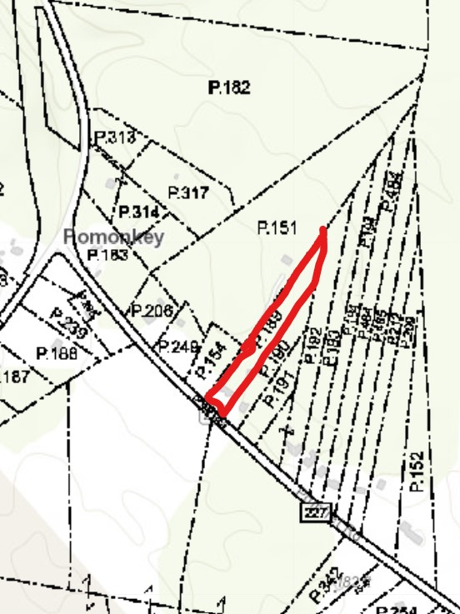

Slide 15
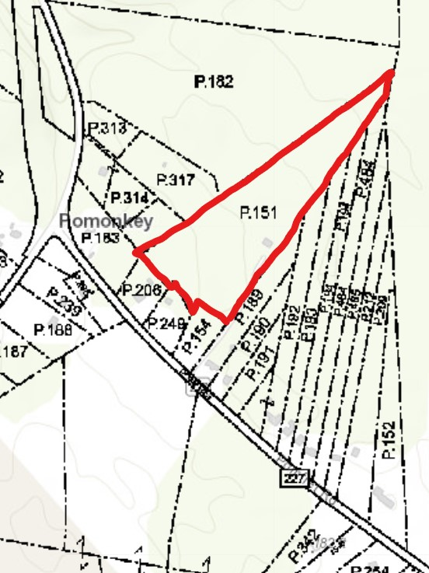

Slide 16
IMPORTANCE OF PAROL EVIDENCE
Owner of Parcel 188 told me he set his PROPERTY CORNERS.
THEN TOLD ME HE SET THE POINTS ON LINE WHERE “THE SURVEYOR” TOLD HIM.
LAST, TOLD ME HE SET THE IRON PIPE AT THE SOUTHEAST CORNER AND THAT HIS PROPERTY WAS ABOUT TEN FEET OVER (TO THE WEST).

Slide 17
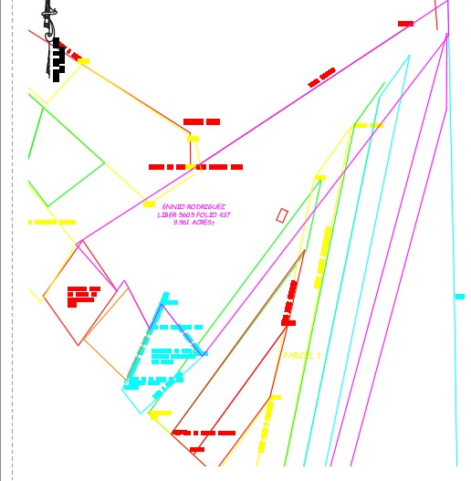
APPLICATION OF THE STATUTE
WHAT DO YOU DO?

Slide 18
DEED RESEARCH

Slide 19
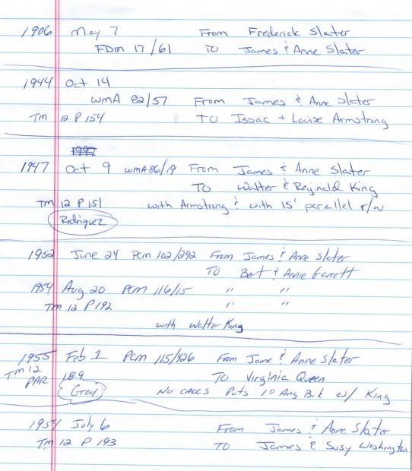
DEED RESEARCH

Slide 20
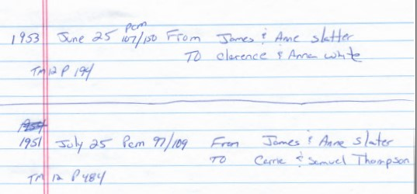
DEED RESEARCH

Slide 21
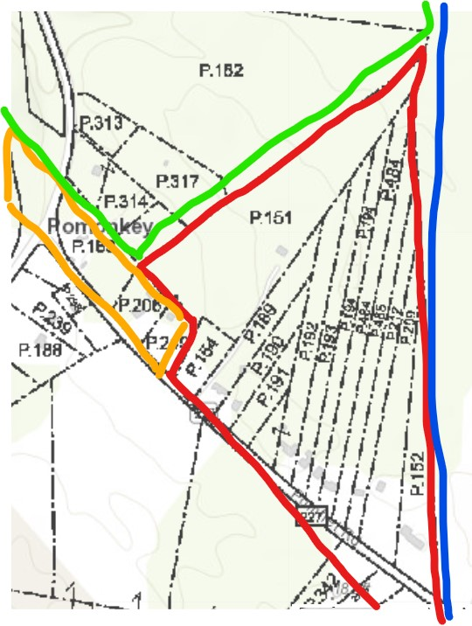
DEED MOSAIC
1906

Slide 22
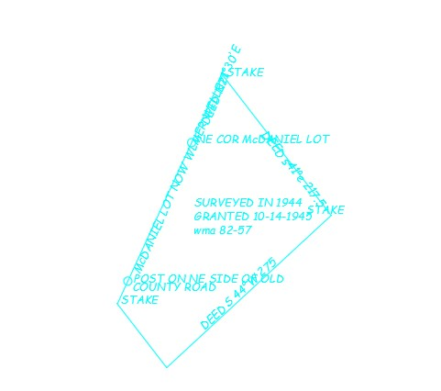
DEED MOSAIC 1944
(OVER EVIDENCE)

Slide 23

DEED MOSAIC 1947
(OVER EVIDENCE)

Slide 24
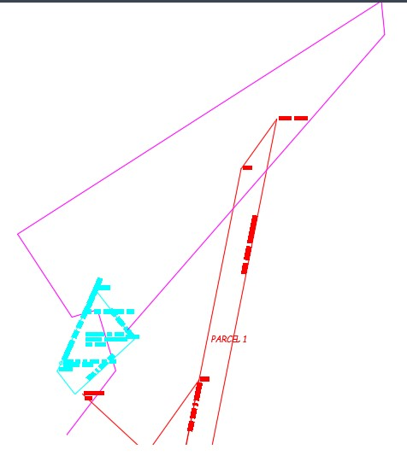
DEED MOSAIC 1952
(OVER EVIDENCE)

Slide 25
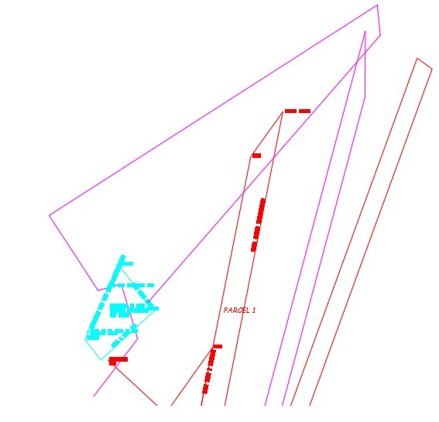
DEED MOSAIC 1954
(OVER EVIDENCE)

Slide 26
DEED MOSAIC 1954
(OVER EVIDENCE)

Slide 27
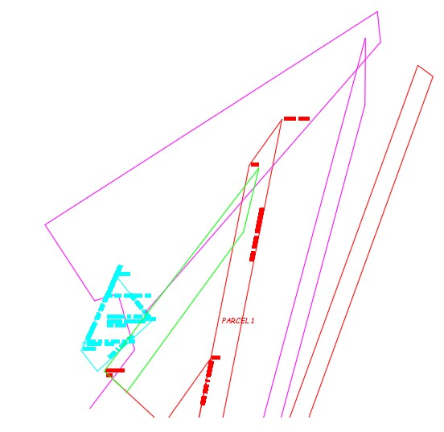
DEED MOSAIC 1955
(OVER EVIDENCE)

Slide 28
WHAT IS NEXT

Slide 29
WHAT IS NEXT

Slide 31
WAS A BOUNDARY SURVEY THE SOLUTION?

Slide 32
QUIET TITLE ACTION
(b) The action may be brought
(1) to compel an adverse party to commence an action of ejectment;
(2) where an action of ejectment will not lie, to determine any right, lien, title or interest in the land or determine the validity or discharge of any document, obligation or deed affecting any right, lien, title or interest in land;
(3) to compel an adverse party to file, record, cancel, surrender or satisfy of record, or admit the validity, invalidity or discharge of, any document, obligation or deed affecting any right, lien, title or interest in land; or
(4) to obtain possession of land sold at a judicial or tax sale. Pa. R.C.P. No. 1061

Slide 33
QUIET TITLE ACTION
PROS
  COURT WILL RESOLVE
    Is this the final step?
      DEEDS ARE NEEDED FOR ALL PARTIES TO CORRECT DESCRIPTIONS AND CLEAR THE TITLE FOR EACH PARCEL
CONS
  COST (SURVEYOR AND LAWYER)
  MUST SUE YOUR NEIGHBORS
ANOTHER SOLUTION
  LINES OF AGREEMENT AND PROPER DEED WORK

Slide 34
The Rest of the Story
(Paul Harvey Style)
There was a prior case where an attorney made a mistake and field for adverse possession.
  That case ended with a consent order.
    In MD consent orders settle the entire case.
Next case was a quiet title action
  My survey and testimony were barred under res judicata
This was appealed and on appeal the court held that the consent order settled the case and part of the consent order was the agreeing to an easement for ingress and egress

Slide 35
The Rest of the Story
(Paul Harvey Style)
The maintenance agreement for the easement utilized a location drawing for an exhibit.
Ultimately the appellate court held that the boundary shown on the location drawing did not establish the boundary but that the consent order confirmed the parties agreed to the boundary on the location drawing.

Slide 36
The Rest of the Story
(Paul Harvey Style)
Part 2
IT GETS WORSE
  CLIENT REPAIRED VEHICLES CONFISCATED BY POLICE
  COUNTY INSPECTORS ARRIVE
    COUNTY SAID HE WAS OPERATING A JUNK YARD
    HOUSE NEEDED REPAIRS
    CLIENT DOES NOT COMPLY PROMPTLY
    COUNTY HAS JUNK DEALER COME AND REMOVE EVERYTHING
      CARS, LAWNMOWERS, SKID STEER, WINDOWS AND SIDING TO REPAIR THE HOUSE, ETC.

Slide 37
The Rest of the Story
(Paul Harvey Style)
Part 2
IT GETS WORSE
  CLIENT HAS TO PAY TO GET SOME OF HIS BELONGING BACK,
  TENS OF THOUSANDS OF DOLLARS SOLD BEFORE HE COULD GET IT BACK OR DENIED IT WAS TAKEN
WHILE THIS IS HAPPENING,
  HIS HOUSE BURNS TO THE GOUND, NOTHING LEFT
COUNTY DISPOSITION
  FINE MY CLIENT $100,000 FOR ZOING VIOLATIONS AND PUT A LIEN ON THE PROPERTY
  PROPERTY NOT WORTH THE FINE, AN EFFECTIVE TAKING

Slide 38
The Rest of the Story
(Paul Harvey Style)
Part 3
THE FUTURE
  HAS A FEDERAL CLAIM UNDER U.S.C. §1883 FOR A FIFTH AMENDMENT TAKING WITHOUT COMPENSATION
  THE CLIENT LET HIS GREEN CARD EXPIRE
    HE WAS NOT LEGAL WHEN THIS HAPPENED
    CAN HE FILE A FEDERAL CLAIM WHEN HE WAS NOT LEGAL?

Slide 39
The Rest of the Story
(Paul Harvey Style)
Part 3
Section 1983 provides: “Every person who, under color of any statute, ordinance, regulation, custom, or usage, of any State or Territory or the District of Columbia, subjects, or causes to be subjected, any citizen of the United States or other person within the jurisdiction thereof to the deprivation of any rights, privileges, or immunities secured by the Constitution and laws, shall be liable to the party injured in an action at law . . . .”
Knick v. Twp. of Scott, 588 U.S. 180, 187, 139 (2019)

Slide 40
STILL NEEDING RESOLUTION
ARE THE BOUNDARY LINES CORRECT?
WHO OWNS THE PROPERTY AND DO THEY GET WHAT IS IN THEIR DEED?
WHAT IS REALLY NEEDED IN THIS SITUATION?
WHAT ABOUT A QUIET TITLE ACTION?

Slide 41
STILL NEEDING RESOLUTION
ARE THE BOUNDARY LINES CORRECT?
WHO OWNS THE PROPERTY AND DO THEY GET WHAT IS IN THEIR DEED?
WHAT IS REALLY NEEDED IN THIS SITUATION?
WHAT ABOUT A QUIET TITLE ACTION?

Slide 42

Contact Information
KEVIN NORRIS, LS, ESQ.
  BRIDGING THE GAP PRODUCTIONS, LLC
  Kevin Scott Norris Law, LLC
  Kevin Norris Surveying, LLC
WWW.BRIDGINGTHEGAPPRODUCTIONS.COM
KEVIN@KSNLAWLLC.COM
(240) 561-7427

